Slide 1
US Coast guard search & rescue watchkeepers need your help:
When ownership of a boat equipped with a marine radio is transferred or sold, the radio’s registered distress identity must be transferred as well.
NASBLA RBS Workshop 2024

Slide 2
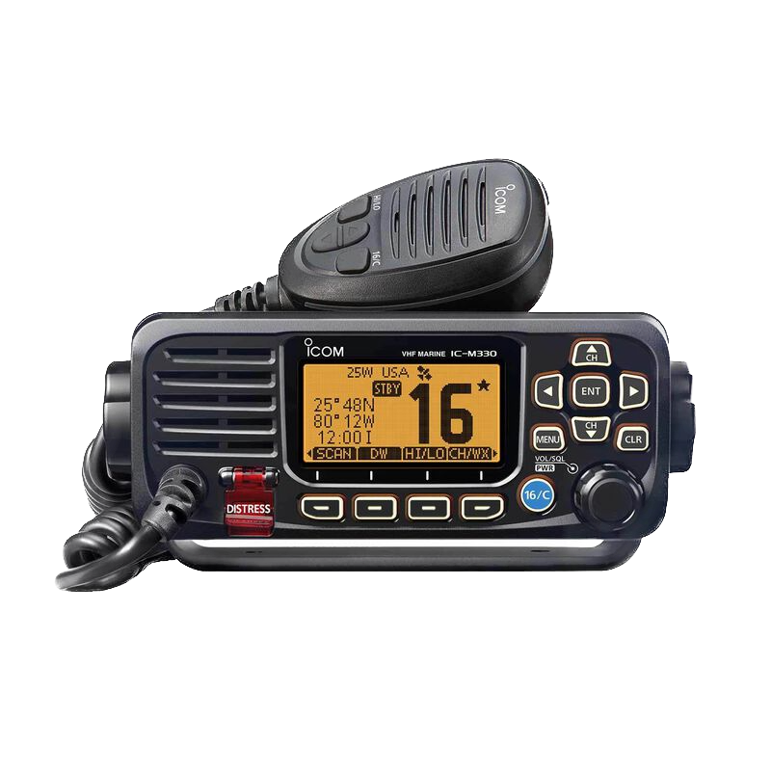
All fixed-mount marine radios have digital distress alert buttons and include registered Maritime Mobile Service Identities (MMSIs) which identify the vessel in distress
DSC distress button, which uses MMSIs and GPS to identify and locate a vessel in distress

Slide 3
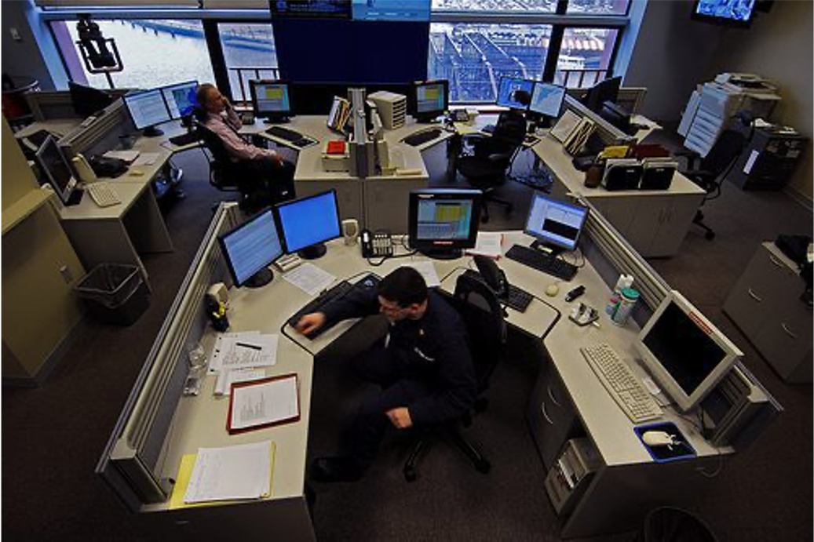
These digital distress alerts are received by Coast Guard Search & Rescue watchstanders, who respond to the distress
If the radio’s MMSI identity is registered to the boat’s original owner rather than the current owner, the Coast Guard contacts the original owner in a distress!

Slide 4
The problem
60% of DSC distress alert identities are invalid, and 76% have no position information (no GPS) -- 2019 USCG statistics, IMO NCSR 8/Inf.9

Slide 5
For Those selling a boat equipped with a marine radio
Contact the radio’s manufacturer for help getting the MMSI identity reset, or
Contact the MMSI registering agent to transfer registration to new owner:
Look up your MMSI registering agent on USCG Navigation Center webpage under Comms, then MMSI
Instructions are on that webpage too (Google “USCG MMSI”)
Federal Communications Commission | U.S. Power Squadrons
BOAT US | Shine Micro

Slide 6
For Those buying a boat equipped with a marine radio
Do Not Complete the Purchase until MMSI on radio has been reset by manufacturer’s instructions, or the original owner has transferred the MMSI registration to you
Instructions are on USCG Navigation Center webpage (Google “USCG MMSI”)

Slide 7
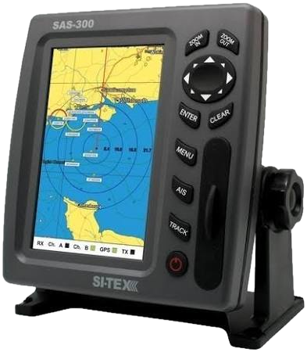
Boats equipped with automatic identification system (AIS)
The MMSI transfer procedures for boats equipped with AIS is the same for as for boats equipped with a marine radio

Slide 8
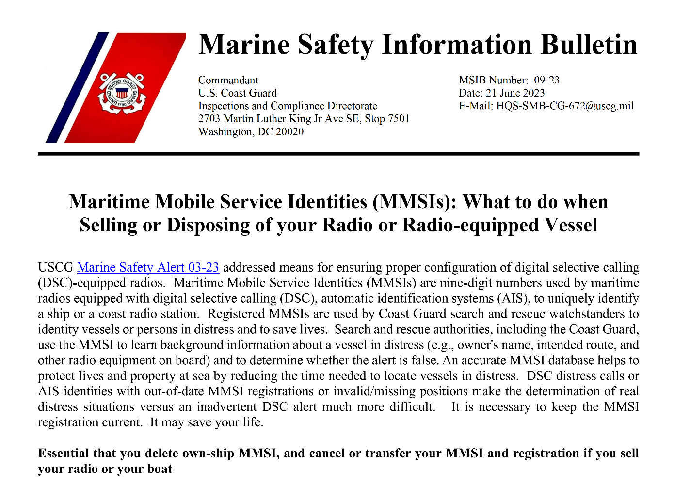
Uscg MSIB Number 09-23
Instructions are on USCG Navigation Center webpage (Google “USCG MMSI”)

